Slide 1

Consumer Goods Ad-hoc Insights

Slide 2
INTRODUCTION
Atliq Hardware is one of the leading computer hardware producers in India and well expanded in other countries too.
The management noticed that they do not get enough insights to make quick and smart data-informed decisions. They want to expand their data analytics team by adding several junior data analysts.
They decided to conduct a SQL challenge which runs Ad-hoc requests to get the business insights

Slide 3
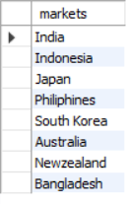
Ad-hoc Request 1 Provide the list of markets in which customer "Atliq Exclusive" operates its business in the APAC region.

Slide 4

Ad-hoc Request 2 What is the percentage of unique product increase in 2021 vs. 2020? The final output contains these fields, unique_products_2020 unique_products_2021 percentage_chg
There is a 67% increase in the products in the year 2021 as compared to the year 2020.
It means there is an increasing demand for products in 2021.

Slide 5
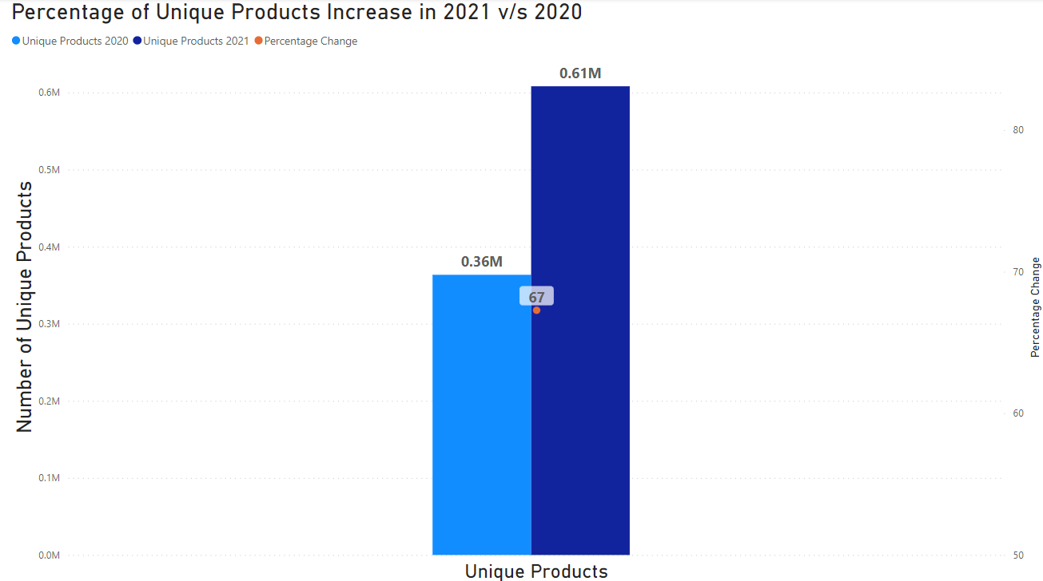
Ad-hoc Request 2 - Visualization

Slide 6
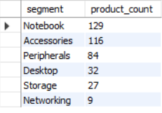
Ad-Hoc Request 3 Provide a report with all the unique product counts for each segment and sort them in descending order of product counts. The final output contains 2 fields, segment and product_count.
Notebook, Accessories, and Peripherals
Are in-demand products of Atliq
Hardware.

Slide 7
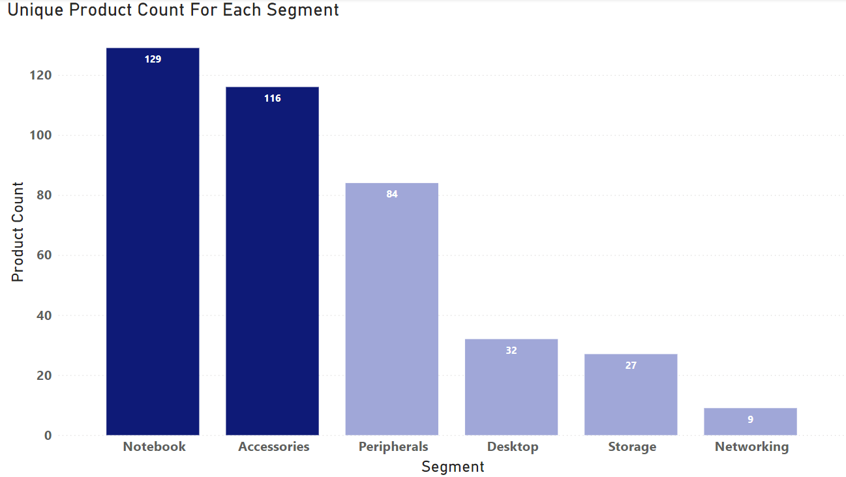
Ad-Hoc Request 3 - Visualization

Slide 8
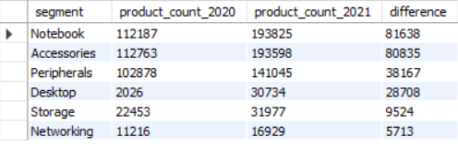
Ad-Hoc Request 4 Follow-up: Which segment had the most increase in unique products in 2021 vs 2020? The final output contains these fields, segment, product_count_2020, product_count_2021, difference
The notebook, accessories, and peripherals segment had the most increase
in products in the year 2021

Slide 9
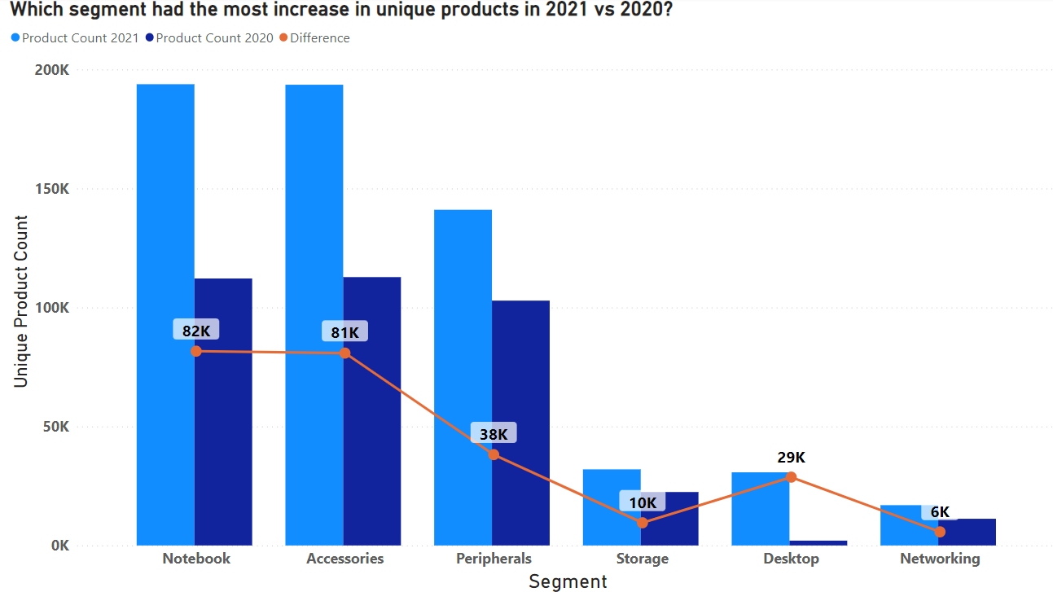
Ad-hoc Request 4 - Visualization

Slide 10

Ad-Hoc Request 5 Get the products that have the highest and lowest manufacturing costs. The final output should contain these fields, product_code, product, manufacturing_cost
AQ Home Allin 1 Gen 2 has the highest manufacturing cost and AQ Master
Wiredx1 Ms has the lowest manufacturing cost

Slide 11
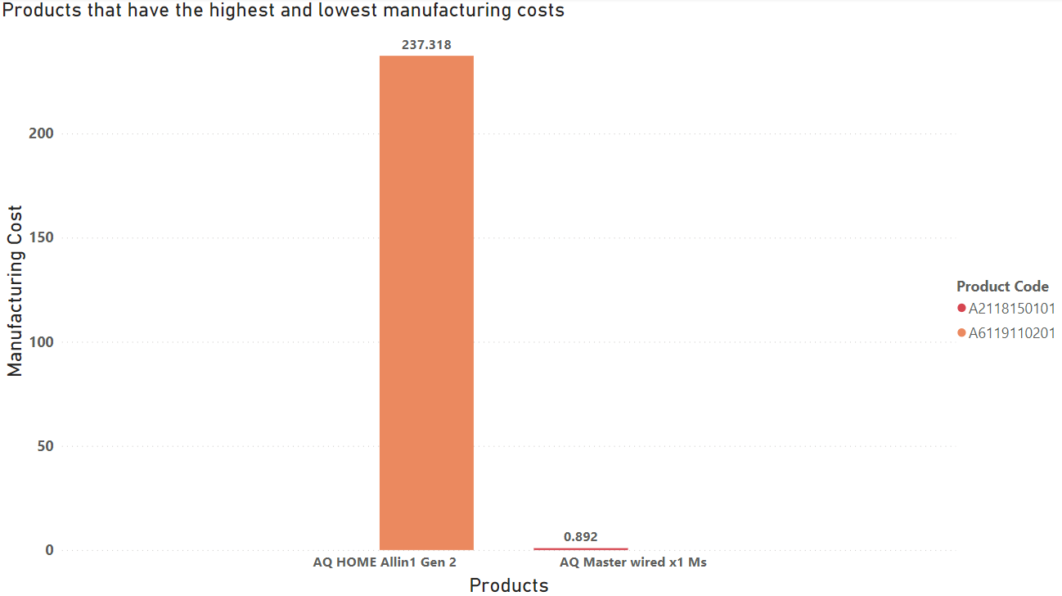
Ad-Hoc Request 5 - Visualization

Slide 12
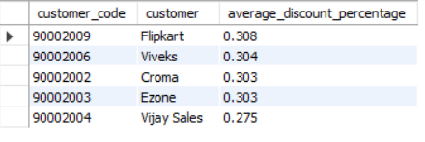
Ad-Hoc Request 6 Generate a report which contains the top 5 customers who received an average high pre_invoice_discount_pct for the fiscal year 2021 and in the Indian market. The final output contains these fields, customer_code, customer, average_discount_percentage
The top 5 customers who received the average high pre invoice discount percent
In Indian market and in fiscal year 2021 are flipkart, viveks, croma, ezone and vijay
Sales.

Slide 13
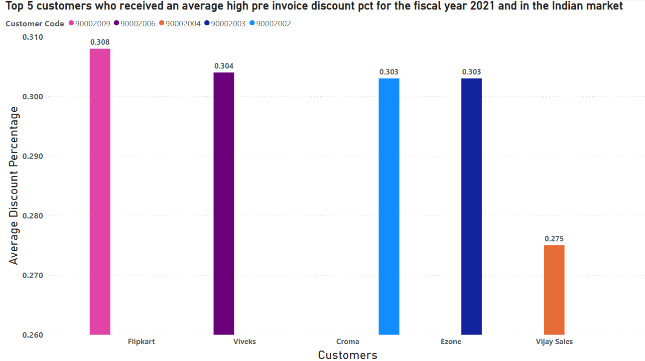
Ad-Hoc Request 6 - Visualization

Slide 14
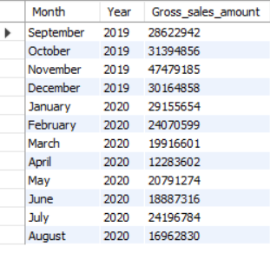
Ad-Hoc Request 7 Get the complete report of the Gross sales amount for the customer “Atliq Exclusive” for each month. This analysis helps to get an idea of low and high-performing months and take strategic decisions. The final report contains these columns: Month, Year, Gross sales Amount
In 2019, low performing month is
September and high performing month
is November while in 2020 high performing
month is January and low performing month
Is april

Slide 15
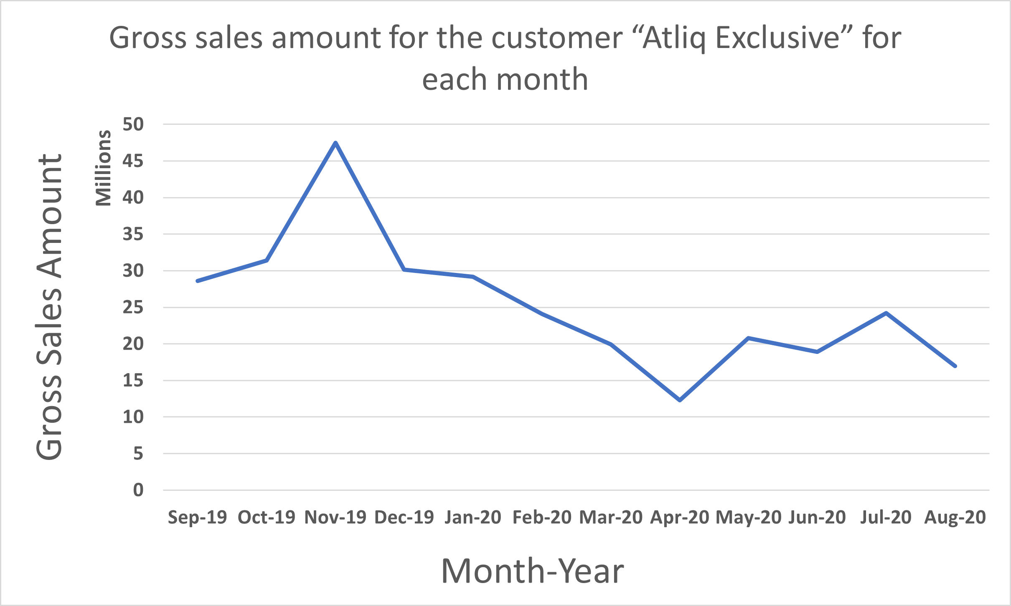
Ad-hoc Request 7 - Visualization

Slide 16
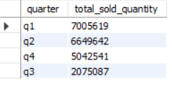
Ad-hoc Request 8 In which quarter of 2020, got the maximum total_sold_quantity? The final output contains these fields sorted by the total_sold_quantity, Quarter, total_sold_quantity
In first quarter of 2020 atliq hardware got the maximum sales. Atliq hardware fiscal
Year start from the month of September, therefore for atliq hardware first quarter is
From September to November

Slide 17
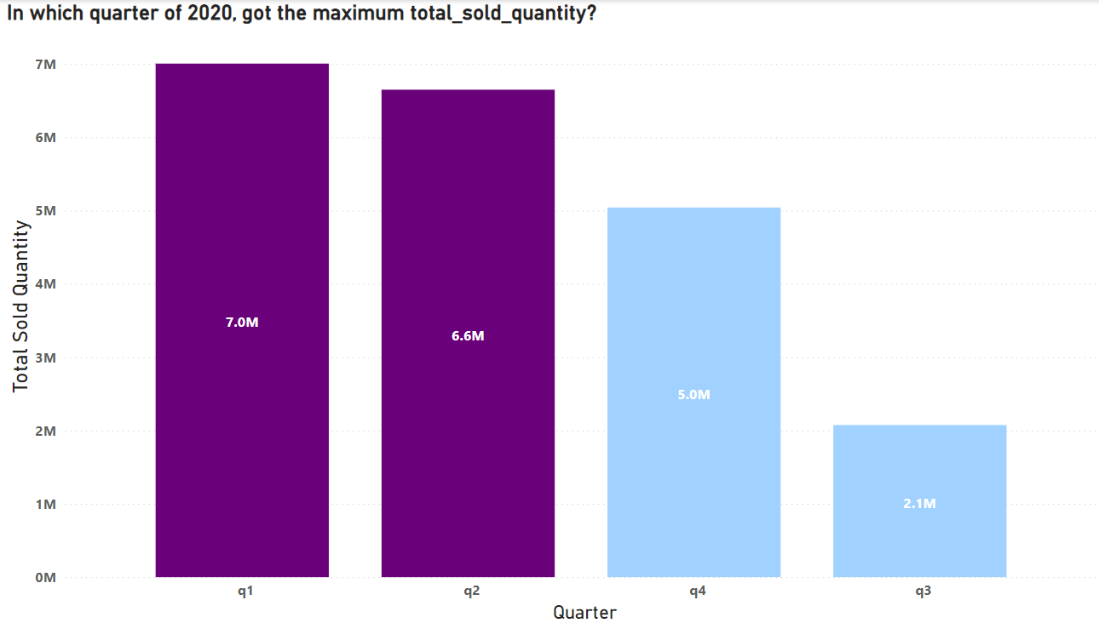
Ad-hoc Request 8 - Visualization

Slide 18

Ad-hoc Request 9 Which channel helped to bring more gross sales in the fiscal year 2021 and the percentage of contribution? The final output contains these fields, channel gross_sales,_mln percentage
Retailer channel brought more gross sales in fiscal year 2021 around 73%.

Slide 19
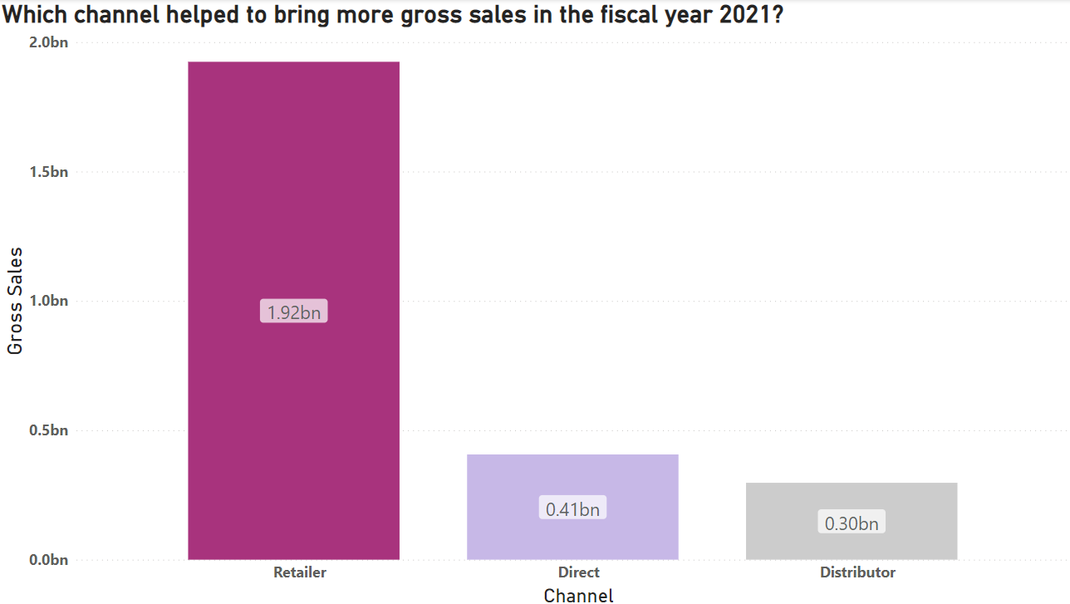
Ad-hoc Request 9 - Visualization

Slide 20
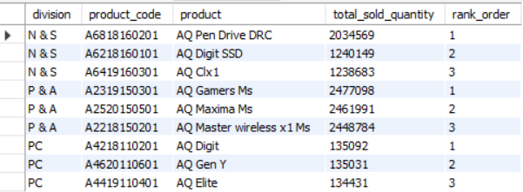
Ad-hoc Request 10 Get the Top 3 products in each division that have a high total_sold_quantity in the fiscal_year 2021? The final output contains these fields, division product_code, product total_sold_quantity, rank_order

Slide 21
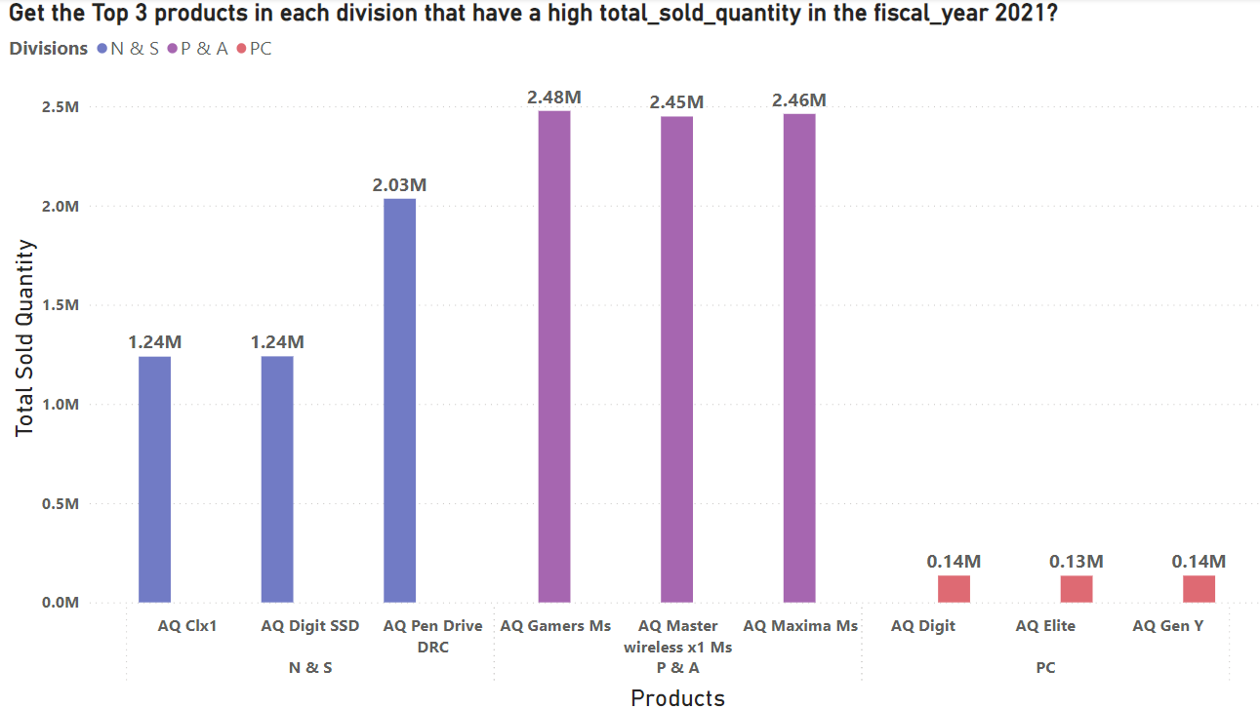
Ad-hoc Request 10 - Visualization

Slide 22
THANK YOU

